Slide 1
EMG analysis

Slide 2
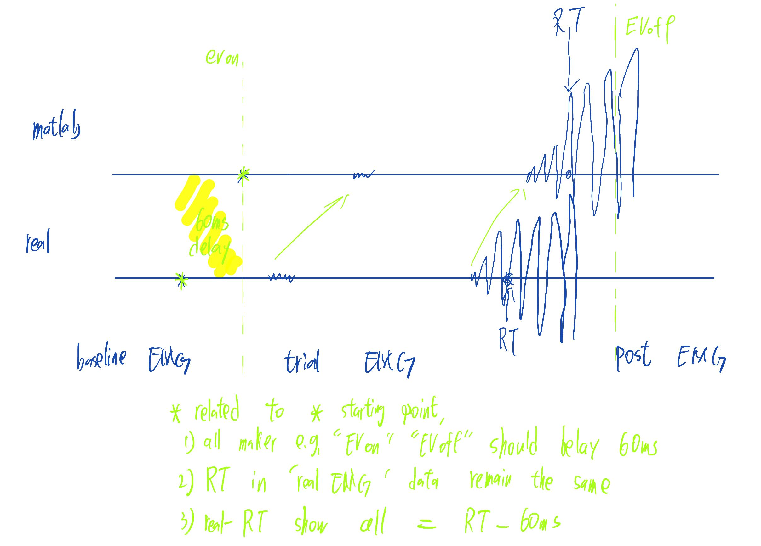
Delay elimination

Slide 3











Slide 4
Rt - EMG onsite time diff.
p-value: 2.442e-22
Confidence Interval: 0.017108 to 0.025685
BCP Motor time 17ms-25ms faster than FDI
Diff. shape means different DM strategy?
FDI 100ms faster; BCP 80ms faster (use for RL update)
Summary Statistics for Data1:
Mean: 0.10088
Median: 0.088457
Standard Deviation: 0.070309
Min: 0.00029868
Max: 0.39395
Interquartile Range (IQR): 0.083657
Summary Statistics for Data2:
Mean: 0.079486
Median: 0.066736
Standard Deviation: 0.063973
Min: 3.0422e-05
Max: 0.39125
Interquartile Range (IQR): 0.072819

Slide 5
EMG onsite (cdf)
The previous difference in RT was due to the same threshold and different MT in different muscles
p-value: 0.73196
Confidence Interval: -0.016667 to 0.023724
Summary Statistics for Data1:
Mean: 0.8951
Median: 0.82775
Standard Deviation: 0.37954
Min: 0.0027579
Max: 1.9819
Interquartile Range (IQR): 0.5083
Summary Statistics for Data2:
Mean: 0.89157
Median: 0.82572
Standard Deviation: 0.38458
Min: 0.0027557
Max: 1.9819
Interquartile Range (IQR): 0.50987

Slide 6


When response left, count burst right (most should =0) BCP is noisy, only see FDI
When response right, count burst right (most should =1) BCP is noisy, only see FDI
When response left, count burst right (most should =0)
When response left, count burst left (most should =1)

Slide 10
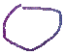


Slide 18
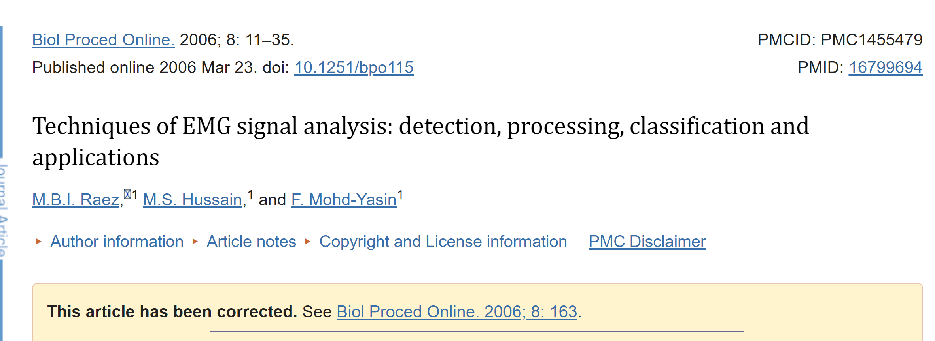
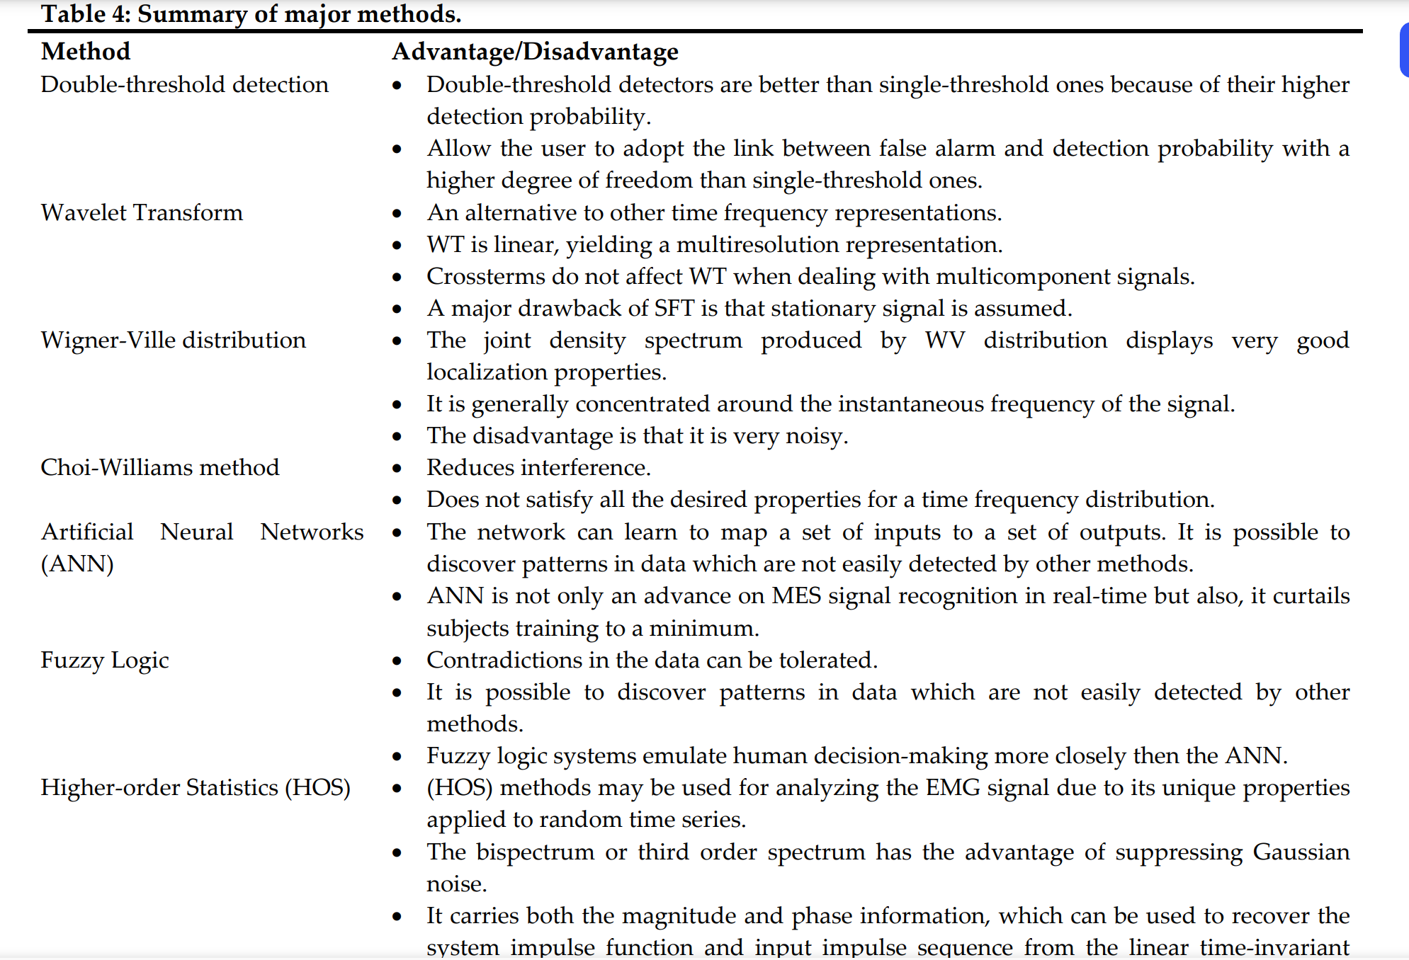



Slide 19
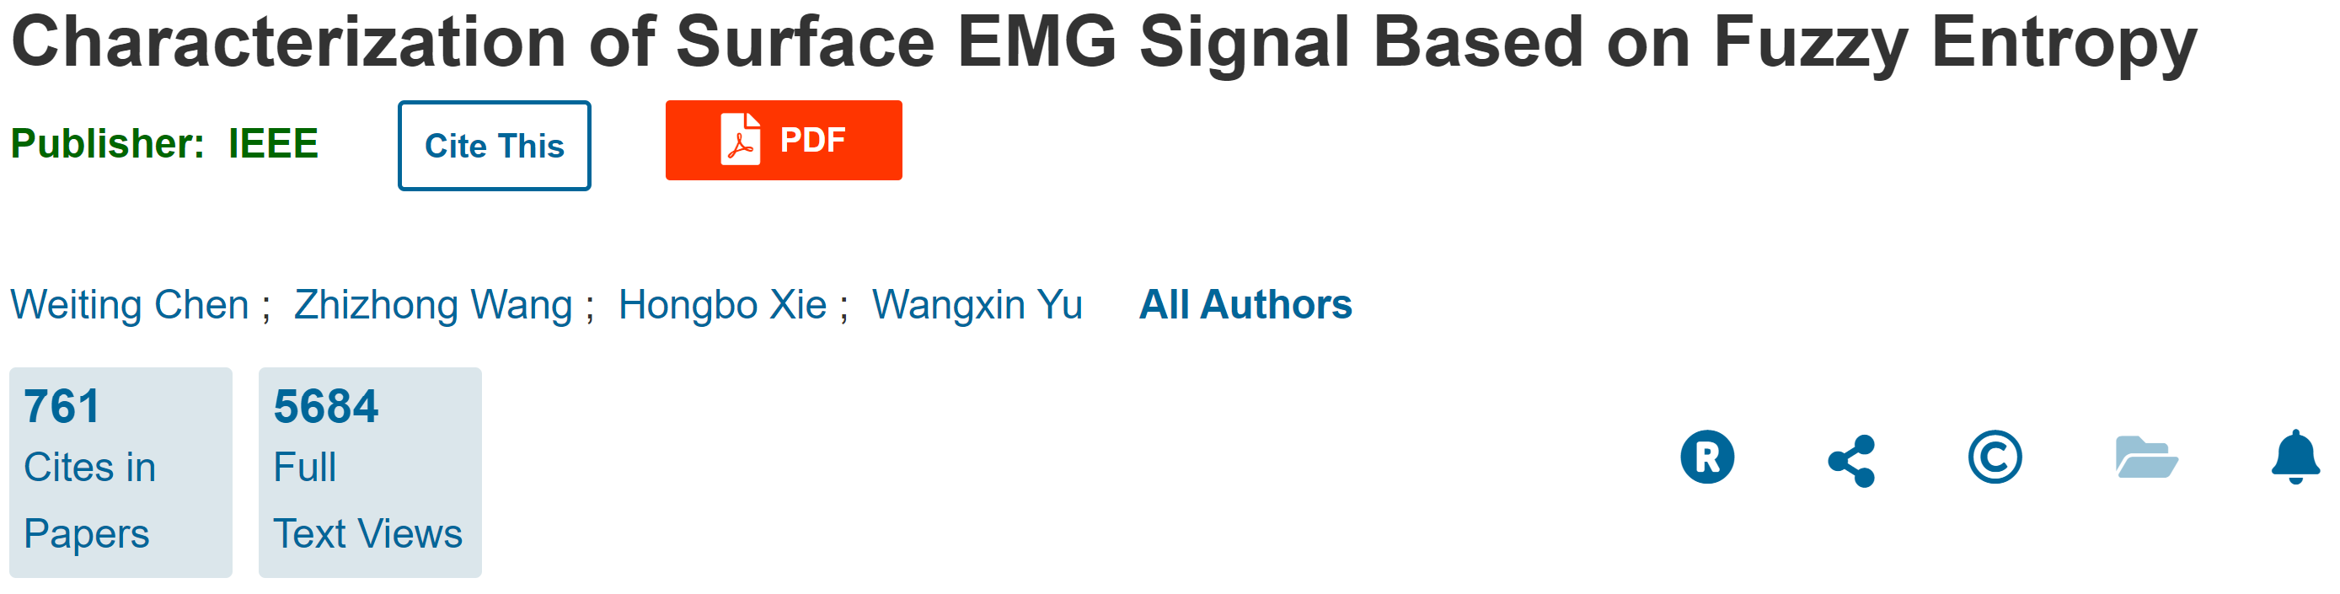
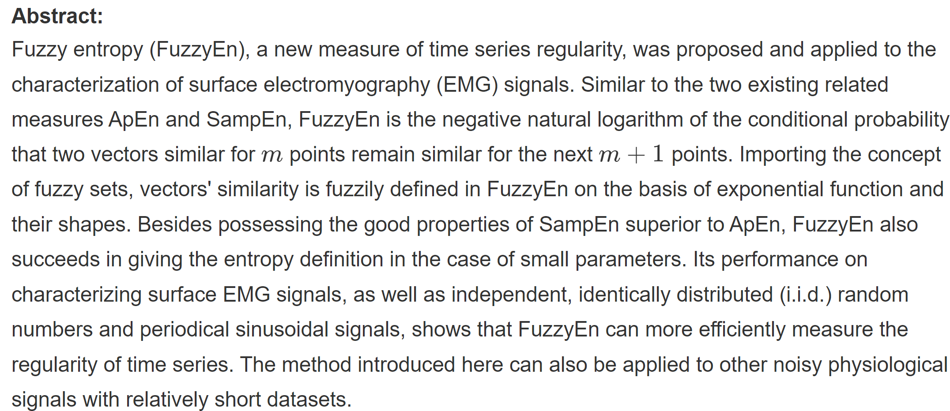


Slide 20



